Slide 1
Scientific Research in Information Systems
Chapter 5
RESEARCH mETHODS
JAN RECKER

Slide 2
Overview
Research Methods
Quantitative Methods
The Focus on Measurement
Reliability
Validity
Measurement Development
Quantitative Method Procedures
Survey Research
Experimental Research
Qualitative Methods
Data Collection Techniques
Data Analysis Techniques
Case Study
Action Research
Grounded Theory
Mixed Methods and Design Science Methods
Mixed Methods
Design Science Methods
Further Reading

Slide 3
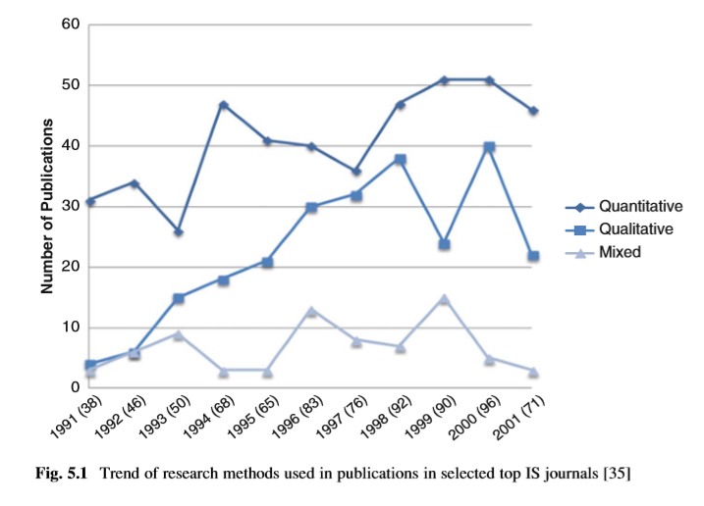
The most popular forms of information systems research
Notes:
The study shows speciﬁcally that quantitative methods dominate (roughly 60% of all published papers), followed by qualitative method papers (roughly 30% on average), and mixed method papers (10%).
Note that the timeframe of the study was 1991–2001; however, other literature reviews report similar statistics.

Slide 4
Quantitative Methods
There are two cornerstones common to such research methods.
the emphasis on quantitative data
an emphasis on positivist philosophy
Quantitative methods focus on how you can do research with an emphasis on quantitative data collected as scientiﬁc evidence.
Research using quantitative methods sets out to study events in the real world, learn about them and their relationships so that general laws can be discovered, explained, and documented.
Notes:
Regarding the ﬁrst cornerstone, quantitative methods tend to specialise in “quantities”, in the sense that numbers are used to represent values and levels of theoretical constructs and the interpretation of the numbers is viewed as strong scientiﬁc evidence of how a phenomenon works.
A positivist philosophy of research is guided by realist and objectivist ontology and an empiricist epistemology.
Together, these assumptions of quantitative methods shape the idea that theories can be proposed that can be falsiﬁed by comparing the theory to carefully collected empirical data.

Slide 5
The Focus on Measurement
Quantitative methods are very focused on the process of measurement.
Measurement provides the fundamental connection between empirical observation and mathematical expression of quantitative relationships.
Measurement is, very simply, the most important thing that a quantitative researcher can do to ensure that the results of the study can be trusted.
Measurement variables must indeed measure the theoretical construct that we wanted to measure (in all its complexity if needed). This step concerns the validity of measurement.
Our measurement variables must indeed measure the theoretical construct consistently and precisely. This step concerns the reliability of measurement.

Slide 6
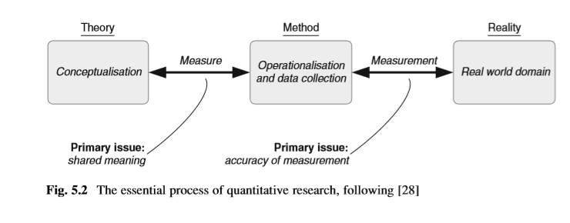
Simpliﬁed form the process of quantitative research
Notes:
Such research starts with developing a theory that offers a hopefully insightful and novel conceptualisation of some important real world phenomena.
In attempting to falsify the theory or to collect evidence in support of that theory, operationalisations are sought and data is collected from a real world domain that are supposedly measuring variables that relate to the operationalised conceptualisation of our theory.

Slide 7
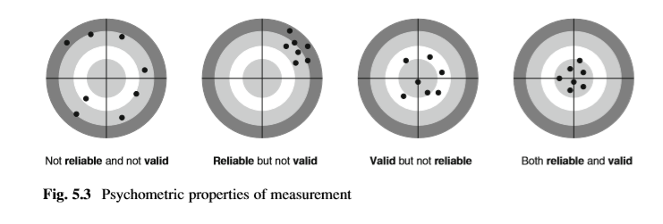
The psychometric properties of measurement variables
Notes:
The worst situation is clearly when our measures are neither reliable nor valid (the left-most image in Fig. 5.3). In such a case, we cannot trust that the measurement variables of our operationalisation have shared meaning with the construct we set out to measure and we also cannot trust the accuracy of our data.
A measurement can be reliable but not valid, if it is measuring something very consistently but is consistently off. A good example is that of a mis-calibrated weighing scale (image one that puts another 10 kg on your actual weight). The measurements you will receive are consistent but they don’t reﬂect your actual weight.
Another type of problem exists when a measurement is valid but not reliable. This could be a measurement that is approximating the ‘true’ score of a construct but repeated measurements will yield inconsistent results (like an arrow that is scattered around the target).

Slide 8
Reliability
Reliability describes the extent to which a variable or set of variables is consistent in what it is intended to measure.
Reliability implies that the operations of a study can be repeated in equal settings with the same results.
Sources of reliability problems often stem from a reliance on subjective observations and data collections.
Other sources of reliability problems stem from poorly worded questions that are imprecise or ambiguous, or, simply, by asking respondents questions that they are either unqualiﬁed to answer, unfamiliar with, predisposed to a particular type of answer or uncomfortable to answer.
Notes:
There is a wide range of reliability tests, including internal consistency (also known as Cronbach’s alpha), composite reliability, split-half reliability, test-retest reliability, alternate forms of reliability, inter-rater reliability, and uni-dimensional reliability.

Slide 9
Validity
Validity describes whether the data collected really measure what the researcher set out to measure.
Valid measurements represent the essence or content upon which the construct is focused.
There are different types of validity that are important to identify. Some of them relate to the issue of shared meaning (Fig. 5.2) and others to the issue of accuracy.
There are theoretical assessments of validity (for face and content validity), and empirical assessments of validity (for convergent, discriminant, as well as concurrent and predictive validity)
Notes:
Theoretical assessments assess how well an operationalisation ﬁts the conceptual deﬁnition of the relevant theoretical construct.
Empirical assessments assess how well a measurement behaves in correspondence to the theoretical predictions.

Slide 10
Validity (cont.)
Face validity refers to whether an indicator seems to be a reasonable measure of its underlying construct (“on its face”).
Content validity refers to how well a set of measurement items matches with the relevant content domain of a theoretical construct.
Construct validity is an issue of operationalisation or measurement between constructs.
Two aspects of construct validity are important:
convergent validity indicates the ‘closeness’ of a measure to its theorised construct and is evidenced when items thought to reﬂect a construct converge.
Discriminant validity indicates the extent to which the measurement items posited to reﬂect or “make up” a construct differ from those that are not believed to make up the construct.
Notes:
Face validity appeals to the sensemaking nature of a measure. For example, is annual salary a good measure of job satisfaction? Hopefully you agree that it is not.
Face validity is often assessed by perusing a panel of experts who are well-positioned to rate a set of measurement items on how well they ﬁt the relevant conceptual deﬁnition of a construct.
The key question of content validity is whether the instrumentation (questionnaire items, for example) pulls in a representative manner all of the ways that could be used to measure the content of a given construct.
As with face validity, assessments may include an expert panel that peruse a rating scheme and/or a qualitative assessment technique called Q-Sort.
Construct validity concern is that instrument items selected for a given construct are, when considered together and compared to other latent constructs, a reasonable operationalisation of the construct.

Slide 11
Validity (cont.)
Other types of validity also exist that apply to some aspects of quantitative methods in information systems research.
These include statistical conclusion validity, manipulation validity (in experiments), external validity, predictive validity, ecological validity.
Notes:
statistical conclusion validity, where we assess the appropriate use of statistics to infer whether the presumed independent and dependent variables covary as predicted,
manipulation validity (in experiments), where we assess whether an experimental group (but not the control group) is faithfully manipulated,
external validity, where we assess the extent to which the study ﬁndings can be generalised,
predictive validity, where we assess the degree to which a measure successfully predicts a future outcome that is theoretically expected, or
ecological validity, where we assess the degree to which a study setting approximates faithfully a real-life situation.

Slide 12
Measurement Development
Establishing measurement reliability and validity is a demanding and resource intensive task.
In attempting to develop measurements that pass all tests of reliability and validity several guidelines exist.
Information systems research to date has mostly relied on methodologies for measurement instrument development that build on the work by Gilbert Churchill Jr. in the ﬁeld of marketing.

Slide 13
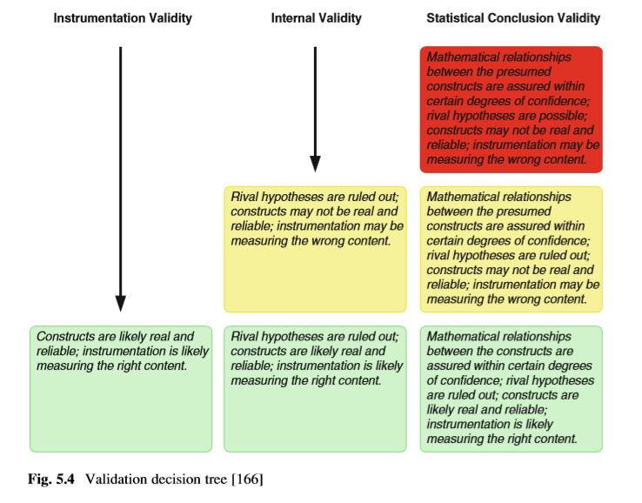
Measurement Development (cont.)
One of the best-known tools to guide researchers in this area is the validation decision tree by Detmar Straub, and which is shown in Fig. 5.4.

Slide 14
Measurement Development (cont.)
The course book offers a procedural model which is helpful speciﬁcally in demonstrating content validity of the measurement instrument.
This model describes in ﬁve stages the different tasks to be performed, related inputs and outputs, and the relevant literature or the source of empirical data where applicable.
item creation
substrata identiﬁcation
item identiﬁcation
item revision
instrument validation
Notes:
The ﬁrst stage of the procedural model is item creation, which is concerned with specifying the theoretical constructs.
The next stage is substrata identiﬁcation, the purpose of which is to sort the candidate items into meaningful separate domain sub categories to display construct, convergent and discriminant validity.
The third stage is item identiﬁcation, the purpose of which is to identify from the pool of candidate items a revised set of items that show good potential for high content validity.
The fourth stage is item revision, the purpose of which is to re-specify and further improve the set of candidate items as well as to get an initial indication of reliability and validity.
The last stage is instrument validation, which is concerned with obtaining statistical evidence for reliability and validity of the developed measurement items.

Slide 15
Quantitative Method Procedures
Research using quantitative methods often follows a linear process model:
1. Generation of models, theories and hypotheses
2. The development of instruments and methods for measurement
3. Collection of empirical data, sometimes through experimental control and manipulation of variables
4. Statistical modelling and/or other analysis of data
5. Evaluation of results
Notes:
The procedure model in this instance covers many types of techniques that can be applied in quantitative methods, such as surveys, laboratory experiments, ﬁeld experiments, or other types of ﬁeld studies such as cases, focus groups, archival analysis, and so forth.
Of these, surveys and laboratory experiments have traditionally been the most dominant techniques in use in information systems research

Slide 16
Survey Research
Surveys are non-experimental research methods that do not involve controlling or manipulating independent variables (that is, they do not contain a “treatment”).
A survey is a means of gathering information about the characteristics, actions, perceptions, attitudes, or opinions of a large group of units of observations, referred to as a population.
Surveys thus involve collecting data about a large number of units of observation from a random sample of subjects in ﬁeld settings through techniques such as mail questionnaires, online questionnaires, telephone interviews, or less frequently through structured interviews or published statistics.
The resulting data is analyzed, typically by using statistical techniques or other quantitative approaches.

Slide 17
Survey Research (cont.)
The survey method is preferable in research contexts
when the central questions of interest about the phenomena are “what is happening” and “how and why” “is it happening?” and
when control of the independent and dependent variables is not possible or not desirable.
Survey research in general can be used for at least three purposes, these being exploration, description, or explanation.
The purpose of survey research in exploration is to become more familiar with a phenomenon or topic of interest.
The purpose of survey research in description is to ﬁnd out about the situations, events, attitudes, opinions, processes, or behaviors that are occurring in a population.
In contrast, the purpose of survey research in explanation is to test theory and hypothetical causal relations between theoretical constructs.
Notes:
Note: Typically, the theory behind survey research involves some elements of cause and effect in that not only assumptions are made about relationships between variables but also about the directionality of these relationships.

Slide 18
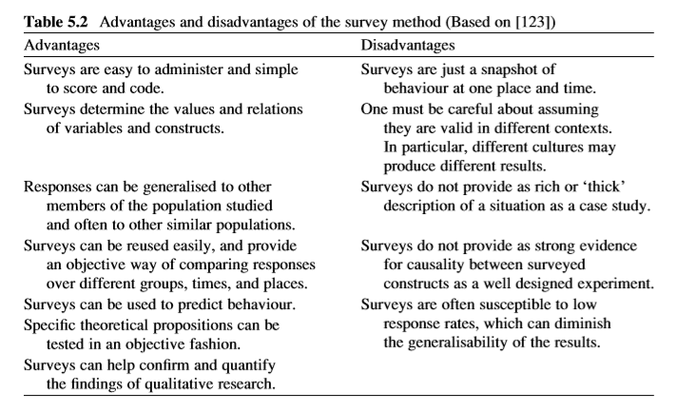
Survey Research (cont.)
Notes:
Table 5.2 lists common strengths and weaknesses.

Slide 19
Survey Research (cont.)
Essentially, good survey research should follow the following guidelines:
Report the approach used to randomize or select samples. (whether the survey used simple random sampling, clustering, stratiﬁcation or other forms of selecting sub-groups of the population)
Report a proﬁle of the sample frame. (Reporting the boundaries of the sample frame)
Report the characteristics of respondents. (whether particular characteristics are representative of the sample.)
Append the whole or part of the questionnaire. (the researcher provides readers with the exact wording of questions.)
Establish the validity and reliability of the survey instrument. (IS researchers must validate their research instruments.)
Perform an instrument pre-test. (Its purpose is to help produce a survey form that is more usable and reliable.)
Report on response rate. (Obtaining a large sample would be meaningless without consideration of the response rate.)

Slide 20
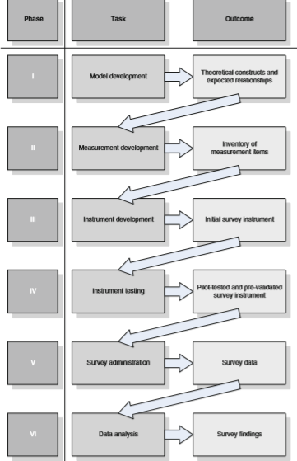
Survey Research (cont.)
Notes:
The procedure distinguishes six stages of survey research: model development, scale development, instrument development, instrument testing, survey administration, and data analysis.

Slide 21
Survey Research (cont.)
Model development is the exercise of theorizing anticipated effects between the phenomena under observation in a well-speciﬁed theoretical model.
Measurement development is concerned with developing measurement arrays (one or more measurement items, for example) that can be used as an operationalization of the theoretical constructs to be measured empirically.
Instrument development is the step of converting measurement inventories into complete survey instruments.
Instrument testing is the step of trying out the survey prior to administering it to the target population of interest, to identify and rectify problems up-front.
Survey administration concerns the actual roll-out of the survey to the target population.
Data analysis ﬁnally concerns the examination of the collected survey data through appropriate quantitative data analysis techniques.
Notes:
Three objectives are typically pursued when doing pre-tests of survey instruments:
Evaluate the authenticity of the questions,
Evaluate the survey interface and layout, and
Establish validity and reliability of the survey instrument.

Slide 22
Experimental Research
Experimental studies are those are that are speciﬁcally intended to examine cause and effect relationships.
This is done by deliberately imposing some treatment to one group of respondents (the treatment group) but not to another group (the control group) while also maintaining control over other potential confounding factors in order to observe responses.
A typical way this is done is to divide the subjects into groups randomly where each group is being “treated” differently so that the differences in these treatments result in differences in responses across these groups as we hypothesize.
Notes:
A treatment is something that an experimenter administers to the subjects (also known as experimental units) so that the experimenter can observe a response.
The treatment is thus how the independent variable is operationalized or realized into data.

Slide 23
Experimental Research (cont.)
Experiments are called true experimental designs if participants are randomly assigned to treatment or control groups. In quasi-experimental designs, random assignment is not followed.
The primary strength of experimental research over other methods is the emphasis on internal validity due to the availability of means to isolate, control and examine speciﬁc variables (the cause) and the consequence they provoke on other variables (the effect).
Its primary disadvantage is often a lack of ecological validity because the desire to isolate and control variables typically comes at the expense of realism of the setting.
Experimental research is often considered the gold standard in research as it is one of the most rigorous forms of collecting and analyzing data, but it is also one of the most difﬁcult research methods.
Notes:
Notes:
Real world domains are often much more complex than the reduced set of variables that are being examined in an experiment.
Experimental research relies on very strong theory to guide construct deﬁnition, hypothesis speciﬁcation, treatment design, and analysis.
Any design error in experiments renders all results invalid.
Moreover, experiments without strong theory tend to be ad hoc, possibly illogical, and meaningless because you essentially ﬁnd some mathematical connections between measures without being able to offer a justiﬁcatory mechanism for the connection.

Slide 24
Experimental Research (cont.)
The most important basic concepts in experiments:
Treatment
The treatment describes an experimental stimulus that is provided to some participants but not to others.
The treatment is considered successful if the responses from the treatment group upon reception of the treatment are different as expected from the responses from the control group that did not receive the treatment.
Treatment manipulation concerns the control for the cause in cause effect relationships by identifying the appropriate type and number of stimulus levels (provision versus non-provision, low/medium/high levels of stimulus and so forth).
Experimental designs typically involve a phase prior to treatment manipulation, called pre-test measures, and most often a phase after treatment manipulation, called post-test measures.

Slide 25
Experimental Research (cont.)
The most important basic concepts in experiments:
Controls
Controls are the mechanisms employed to ensure that the different responses observed are indeed due to the treatments and not other confounding factors.
Thus, in experiments, sources of potential bias and confounding inﬂuences that could prevent the actual effect of the treatment from being observed need to be identiﬁed and controlled for.
For example, in medicine, since many patients are conﬁdent that a treatment will positively affect them, they react to a control treatment that actually has no physical affect at all such as a sugar pill. This phenomenon is called the placebo effect.
For this reason, it is common to include control, or placebo, groups in medical experiments to evaluate the difference between the placebo effect (no treatment or zero-treatment) and the actual effect of the treatment.

Slide 26
Experimental Research (cont.)
The most important basic concepts in experiments:
Randomization
Randomization is the process of selecting a sample from a population in such a way that any personal characteristics or predispositions do not interfere with the treatment or any response to the treatment.
One key bias that can creep into experiments is the effect of subjects’ differences in terms of experience, risk adversity, and knowledge among others.
A critical aspect of experimental design is therefore ensuring that either such bias is accounted for during data analysis (by administering appropriate controls) or designing the experiment so that such biases are evenly distributed across the groups (and thus cancel each other out).
One way to achieve this is by matched allocation of subjects to different groups thereby ensuring that there are equal numbers of risk-takers and risk-averse individuals in both groups for example.
Notes:
Matching allocation is expensive and not possible most of the time as there could be a vast multitude of personal characteristics that could result in bias, and it is impossible to match subjects or all these characteristics.
Random assignment of participants to experimental groups is thus most often employed to ensure that the experimental groups are similar in their characteristics.

Slide 27
Experimental Research (cont.)
The most important basic concepts in experiments:
Experimental designs
Experimental designs can vary. The most popular design types in basic design notation are true experimental designs and quasi experimental designs.
The simplest form of a true experimental design is a two-group design involving one treatment group and one control group, and possibly pre- and/or post-tests.
More sophisticated true experimental designs include covariance designs where measures of dependent variables can be inﬂuenced by extraneous variables called covariates.
Other studies require factorial designs that involve manipulation of two independent variables (treatments). Each independent variable then denotes a factor and each manipulation describes a factor level.
Notes:
Factorial designs have higher sample size requirements because we need to ensure that we receive sufﬁcient responses for each treatment group (“cell”) to allow for meaningful data analysis (to achieve stable results with signiﬁcance levels).

Slide 28
Experimental Research (cont.)
The most important basic concepts in experiments:
Experimental designs
Experimental designs can vary. The most popular design types in basic design notation are true experimental designs and quasi experimental designs.
Quasi-experimental designs are similar to true experimental designs, with the difference being that they lack random assignment of subjects to groups.
The most common forms are non-equivalent groups design – the alternative to a two-group pre test post test design, and non-equivalent switched replication design, in which an essential experimental treatment is “replicated” by switching the treatment and control group in two subsequent iterations of the experiment.

Slide 29
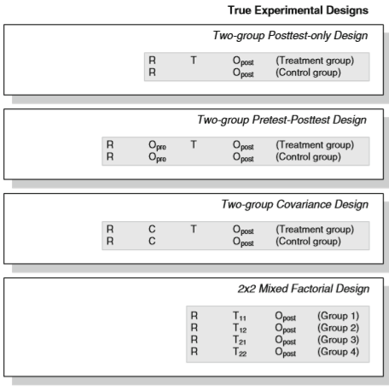
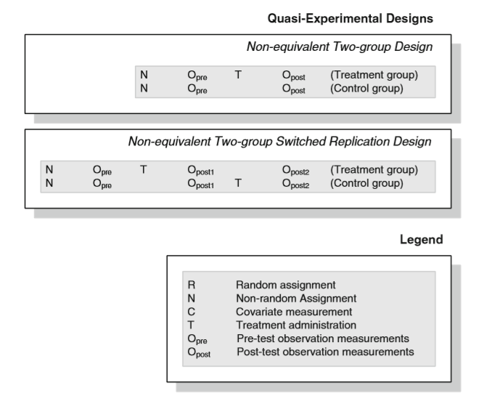
Experimental Research (cont.)

Slide 30
Experimental Research (cont.)
The most important basic concepts in experiments:
Data analysis
Data analysis concerns the examination of quantitative data in a number of ways.
Descriptive analysis refers to describing, aggregating, and presenting the constructs of interests or the associations between the constructs to describe, for example, the population from where the data originated, the range of response levels obtained, and so forth.
Inferential analysis refers to the statistical testing of hypotheses – the suspected cause and effect relationships – to ascertain whether the theory receives support from the data within certain degrees of conﬁdence, typically described through signiﬁcance levels.
Most of these analyses are nowadays conducted through statistical software packages such as SPSS, SAS, or mathematical programming environments such as R or Mathematica.

Slide 31
Experimental Research (cont.)
The most important basic concepts in experiments:
Data analysis
Data analysis relies on data that is coded appropriately. Data coding refers to converting raw data into appropriate numerical formats. (into ratio scales, numerical scales, binary scales, ordinal scales or others).
With coded data, multiple analyses can be conducted. Univariate analyses concern the examination of one variable by itself, to identify properties such as frequency, distribution, dispersion, or central tendency. Classic statistics involve mean, median, variance, or standard deviation.
Bivariate analyses concern the relationships between two variables. For example, we may examine the correlation between two numerical variables to identify the changes in one variable when the other variable levels increase or decrease.
Inferential analyses involve estimation of general linear models (GLM) or two group comparisons to examine hypotheses statistically. A common technique relies on the Student t-test that examines whether the mean of a dependent variable differs signiﬁcantly between two groups

Slide 32
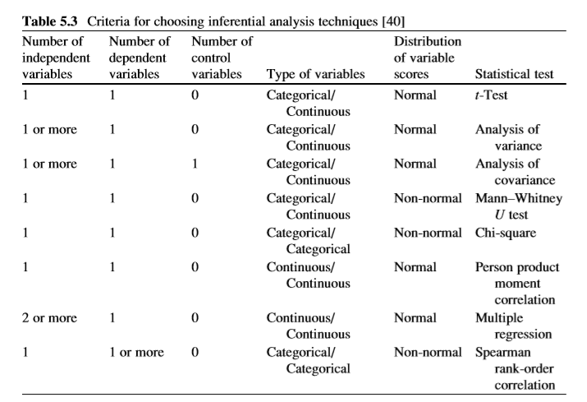
Experimental Research (cont.)
Notes:
The choice of the correct inferential analysis technique is dependent on the chosen experimental design, the number of independent and dependent (and control) variables, the data coding and the distribution of the data received.

Slide 33
Further Reading
Boudreau, M.-C., Gefen, D., Straub, D.W.: Validation in information systems research: A state-of-the-art assessment. MIS Q. 25, 1–16 (2001)
Churchill Jr., G.A.: A paradigm for developing better measures of marketing constructs. J. Mark. Res. 16, 64–73 (1979)
Creswell, J.W.: Research Design: Qualitative, Quantitative, and Mixed Methods Approaches, 3rd edn. Sage, Thousand Oaks (2009)
de Vaus, D.A.: Surveys in Social Research, 5th edn. Taylor & Francis Books, London (2001)
Fink, A., Kosecoff, J.: How to Conduct Surveys: A Step-by-Step Guide. Sage, Beverly Hills (1985)
Haenlein, M., Kaplan, A.M.: A beginner’s guide to partial least squares analysis. Underst. Stat. 3, 283–297 (2004)
J€oreskog, K.G., S€orbom, D.: LISREL 8: User’s Reference Guide. Scientiﬁc Software International, Lincolnwood (2001)
Recker, J.: Evaluations of Process Modeling Grammars: Ontological, Qualitative and Quantitative Analyses Using the Example of BPMN. Springer, Berlin (2011)
Robson, C.: Real World Research, 2nd edn. Blackwell, Oxford (2002)
Shadish, W.R., Cook, T.D., Campbell, D.T.: Experimental and Quasi-experimental Designs for Generalized Causal Inference, 2nd edn. Houghton Mifﬂin, Boston (2001)
Straub, D.W., Boudreau, M.-C., Gefen, D.: Validation guidelines for IS positivist research. Commun. Assoc. Inf. Syst. 13, 380–427 (2004)

Slide 34
Thank You
☺

